Slide 1
HUNGERZARF
ONLINE FOOD DELIVERY APPLICATION

Slide 2
BACKGROUND OF THE PROJECT
Startup ideas in the food industry always have a chance of survival. Case in point: people need food, and a lot of the time want it delivered right to their door.
Market Value and Revenue Overview:
Statistic estimates the online food delivery market will be $134 billion in 2020. The market is expected to grow to $184 billion by 2024.
The numbers clearly indicate a robust market with demand strong enough to maintain growth even in tough economic conditions. Another interesting fact is that China and the United States contribute to over 70% of the online food delivery market. The global market penetration rate is still less than 10%.

Slide 3
BACKGROUND OF THE PROJECT
Zomato, Uber Eats, and Swiggy have cracked the online food delivery code.
Their technical expertise has propelled them to over 70% market share.
This is a global trend, in which a handful of apps control the entire online delivery industry in a specific region.
The best part is that the companies don’t own a single restaurant – they just know how to connect restaurants with customers.

Slide 4
ABOUT APPLICATION
HungerZarf is an online food delivery application.
It also provides employment to the needy.
HungerZarf was established in the year 2022.
HungerZarf provides a complete solution for products/services through the Internet that helps people and companies communicate in an easy, efficient, and environmentally friendly way.

Slide 5
PROBLEM STATEMENT
USER PERSPECTIVE:
In the present scenario, people have to physically visit the hotels or restaurants for eating food and have to make payments through cash mode most of the time due to unawareness of advanced technologies at certain places. In this method time as well as physical work is required, among which time is something that no one has in ample amount.
The traditional food ordering procedure is not efficient enough for hotels and restaurants, as they have to deal with the crowd, in their restaurant. The old methods can be classified into categories which are paper grounded and verbal grounded. For paper-based work, the waiter comes and pens down foods that customers order and pass the food list containing paper to the chefs or cooks in the kitchen for further process.

Slide 6
PROBLEM STATEMENT
RESTAURANT OWNERS PERSPECTIVE:
Also, from the owner’s point of view maintaining data records and the accounts in the physical file are cumbersome and tedious work to do.
It is difficult to maintain crowds physically.
Many departments are involved in maintaining the database.
And also, it is full of risk as anyone can access it and modify the data.

Slide 7
PROPOSED SYSTEM
This system is a bunch of benefits from various points of view. This online application enables the end-users to register to the system online, select the food items of their choice from the menu list, and order food online. Also, the payment can be made through online mode or at the time of home delivery depending upon the customer’s choice and convenience
FOR USER,
The selection made by the customers will be available to the hotel reception or to the person handling the work assignment. Now this same person will assign the orders to the specialist chef to be completed within a fixed duration of time. As soon as the chef prepares the food, the later person forwards the parcels to the delivery persons assigned with the location and customer identity of the customer along with the bill status.

Slide 8
PROPOSED SYSTEM
FOR RESTAURANT OWNER,
With this application, the workload of the water in the hotels are reduced, or in some situations, their work is abolished.
One of the various benefits of this is system is that if there is a rush or a huge crowd present in the restaurant then in that case sometimes unavailability of tables cut downs the restaurant’s customer

Slide 9
GOALS OF THE PROJECT
We want to give Online Food Delivery Services through the application for various food items as well provide employment to the needy
It wants to give a complete solution for products/services through the Internet
Though this solution they can display and sell their products/services. Customers can see and buy the product/services
GOALS ARE :
To increase customer
Provide a complete package to customers online
To create a user friendly interface which is accessible by all age groups

Slide 10
SYSTEM COMPATABILITY
This project has been tested on the Windows platform with the python robot test module.
Robot Framework is a generic open source automation framework. It can be used for test automation and robotic process automation (RPA). Robot Framework is supported by Robot Framework Foundation. Many industry-leading companies use the tool in their software development. Robot Framework is open and extensible. Robot Framework can be integrated with virtually any other tool to create powerful and flexible automation solutions. Robot Framework is free to use without licensing costs.

Slide 11
BENEFITS OF HUNGERZARF
Order food online from anywhere
Make payments according to your convenience
Job availabilities
Smooth delivery to your doorsteps
Huge variety of food items to choose from

Slide 12
REQUIREMENTS
FUNCTIONAL REQUIREMENTS:
Bill invoice generation
Invoice generating with purchased order
Customer profile
To see his/her order
Make payments online
Admin Panel
Admin can view orders, users. who is contacting and who is applying for job

Slide 13
REQUIREMENTS
NON FUNCTIONAL REQUIREMENTS:
Create a new customer profile in less than 3 seconds
Sending user, a confirmation message in less than 5 seconds
Generate bills of the customer for their order in less than 5 seconds

Slide 14
Tech Stack Used -
HTML
CSS
ROBOT FRAMEWORK
PYCHARM
JAVASCRIPT
FLASK

Slide 15
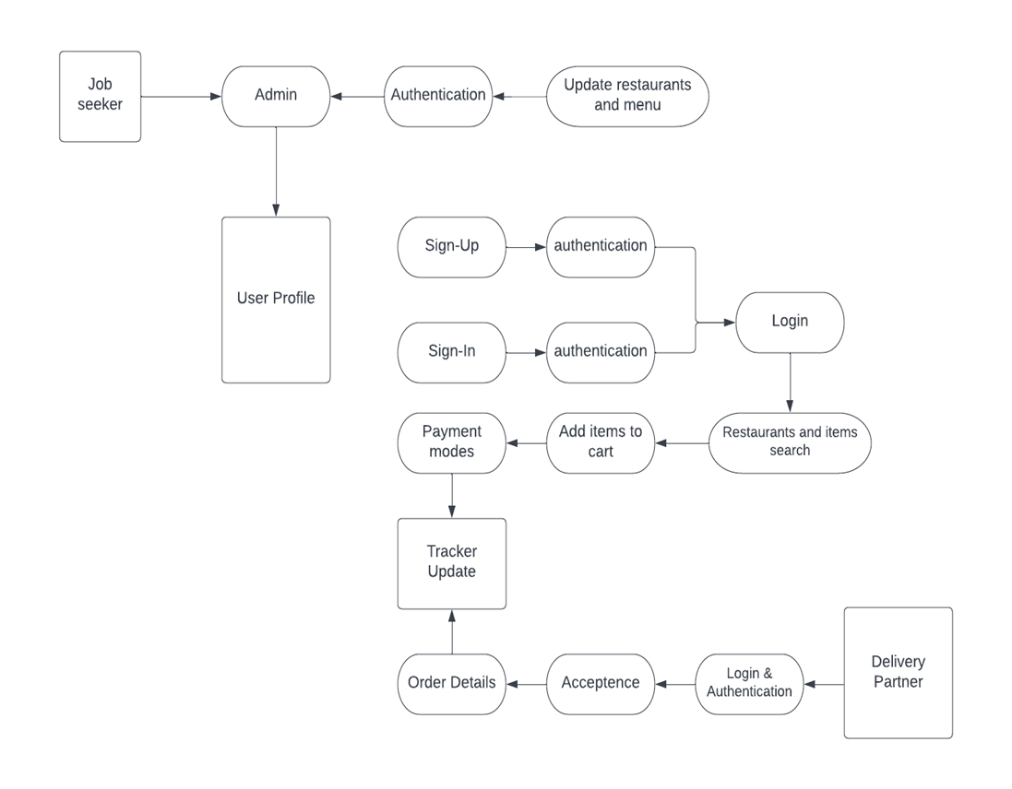
ACTIVITY DIAGRAM

Slide 16
FEATURES OF HUNGERZARF
This project is a database-driven online food delivery website where items are displayed on a webpage and stored in a database.
Job opportunities are added and easily anyone can apply online through our job-seeker portal.
The user can select their favourite exquisite dishes from the menus given out from the database, and make payments online

Slide 17
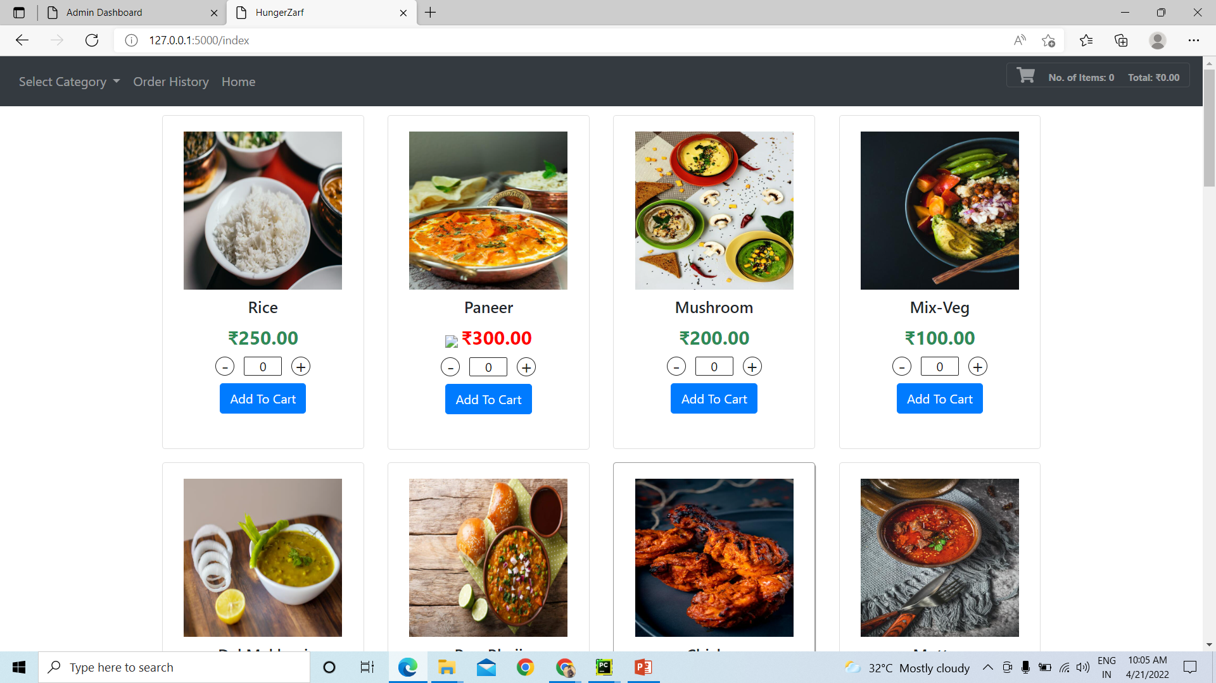
FOOD ITEMS PAGE
Users can select anything they like from this page
Typically, new food items in a lot of different varities will be displayed on the homepage.

Slide 18
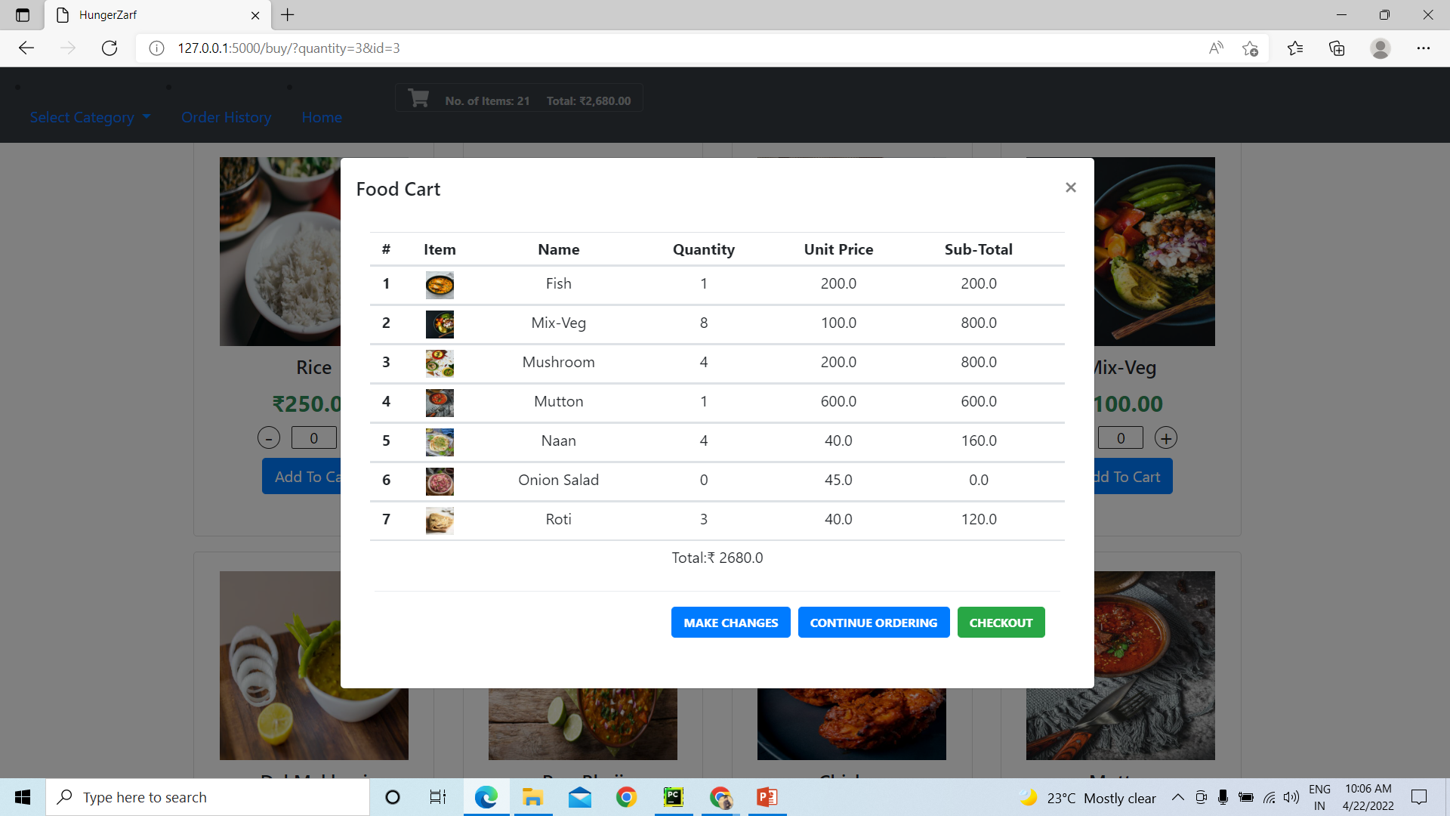
ADD TO CART FUNCTIONALITY

Slide 19
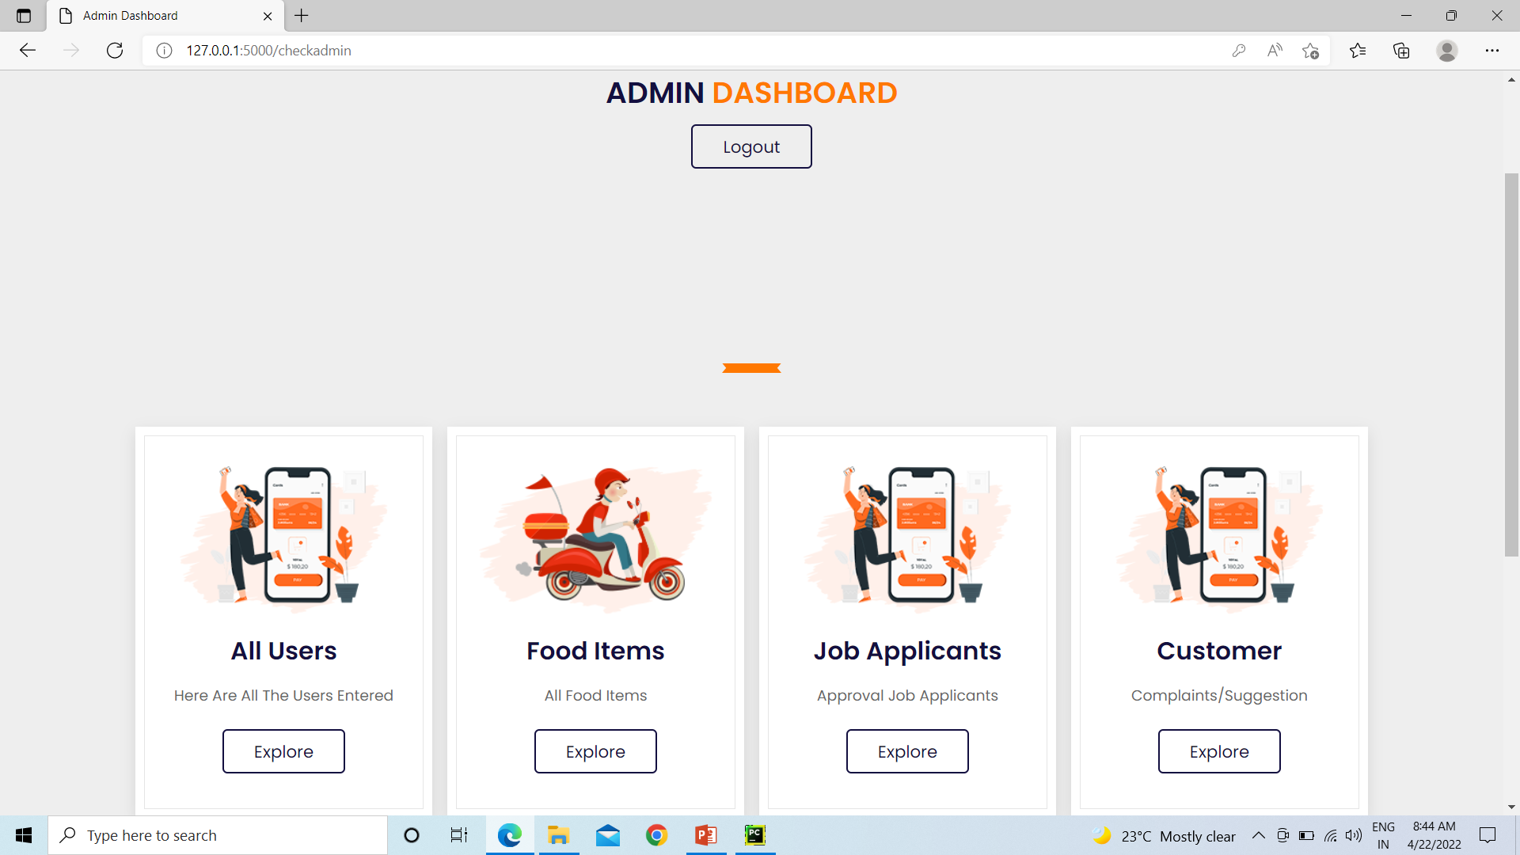
ADMIN DASHBOARD

Slide 20
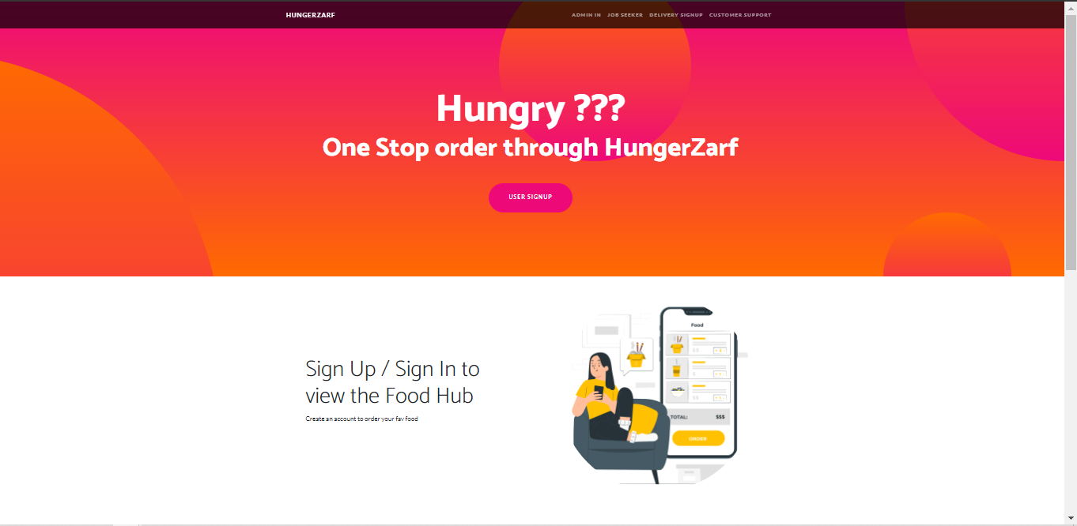
OUR WEBSITE - HOME PAGE

Slide 21
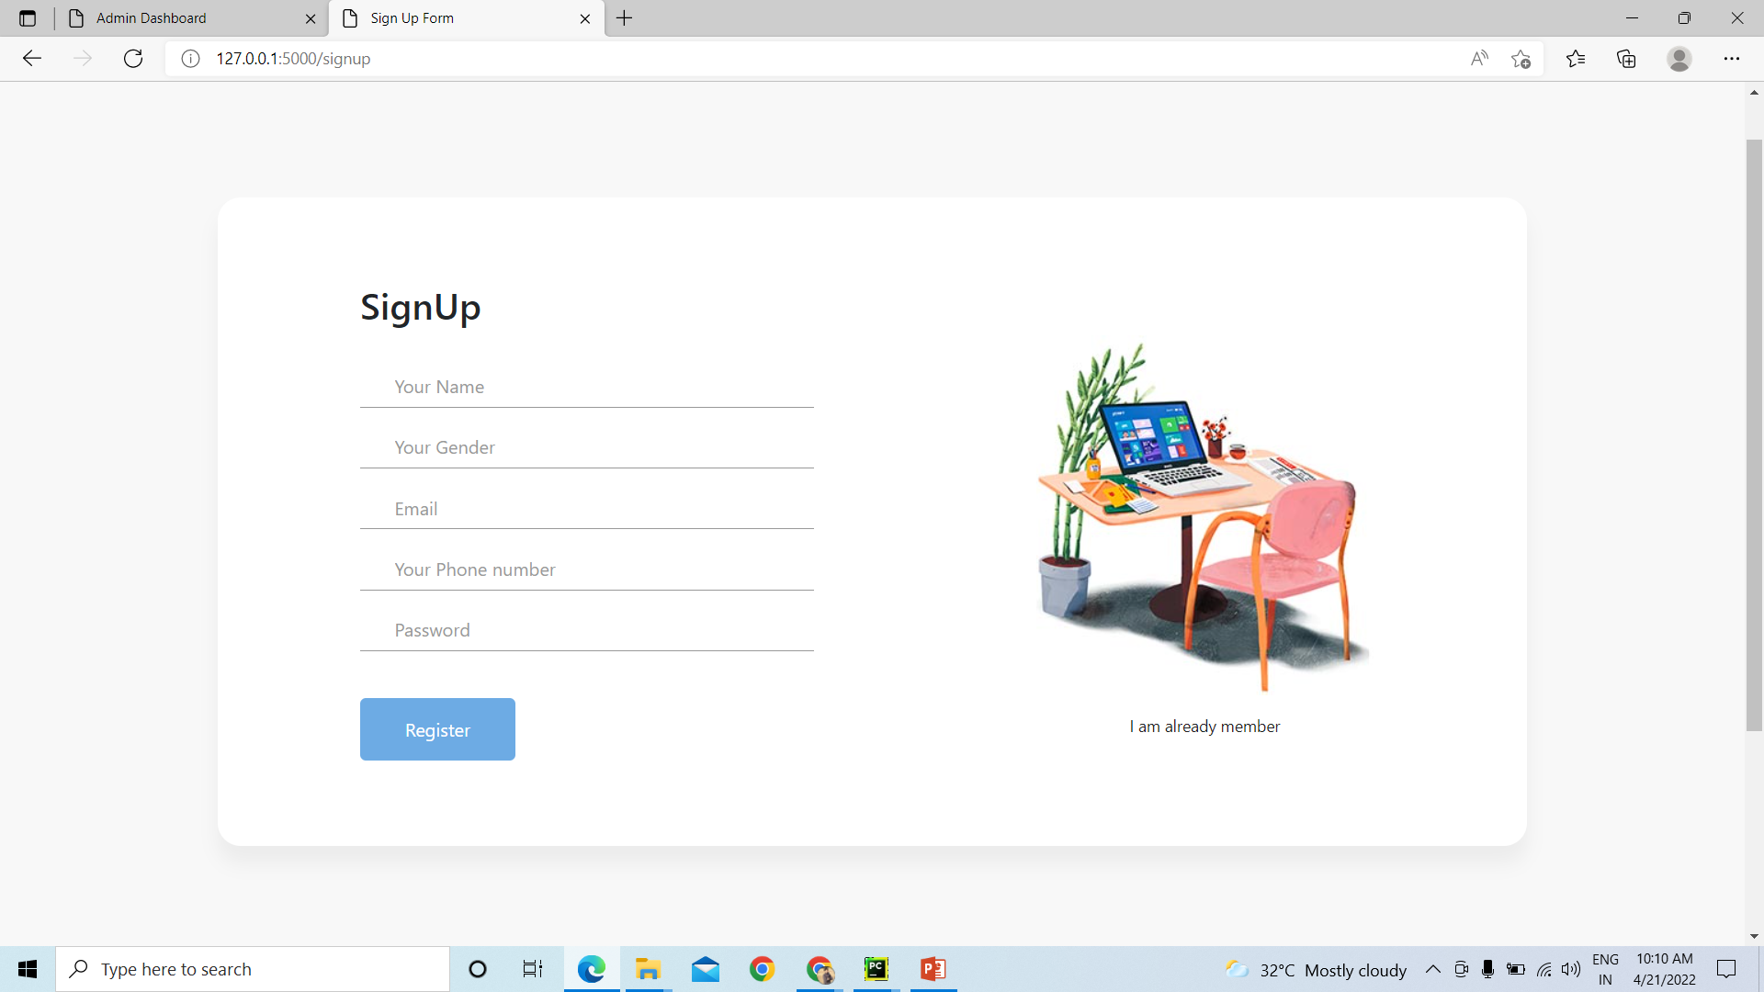
OUR WEBSITE - USER SIGN-IN

Slide 22
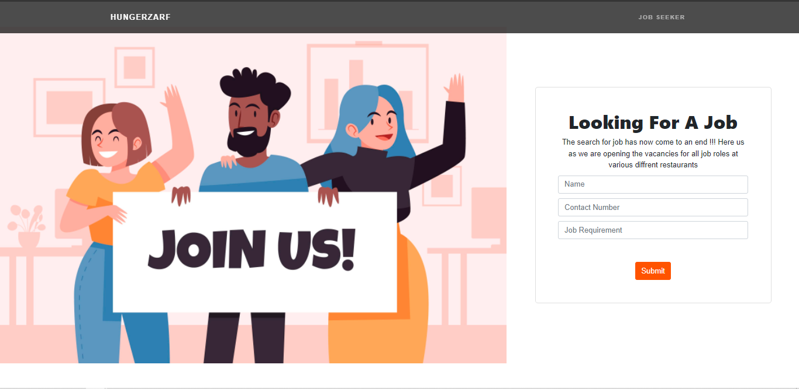
OUR WEBSITE - JOB SEEKER PAGE

Slide 23
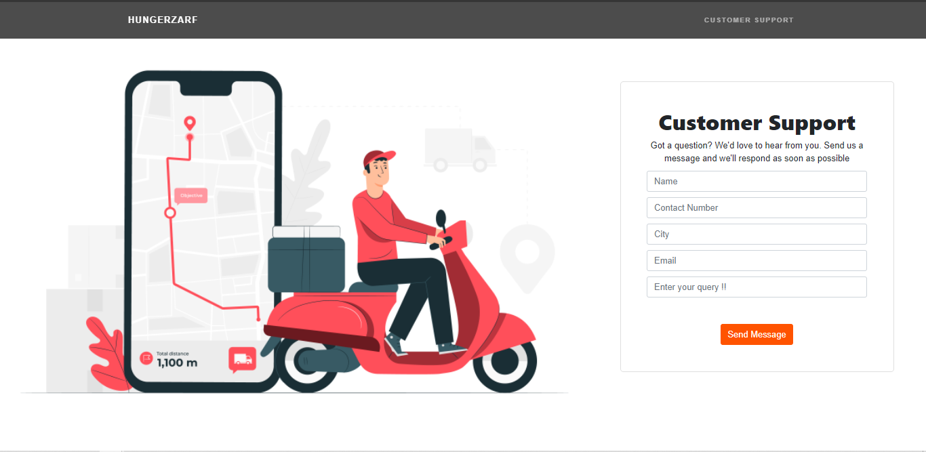
OUR WEBSITE - CUSTOMER SUPPORT PAGE

Slide 24
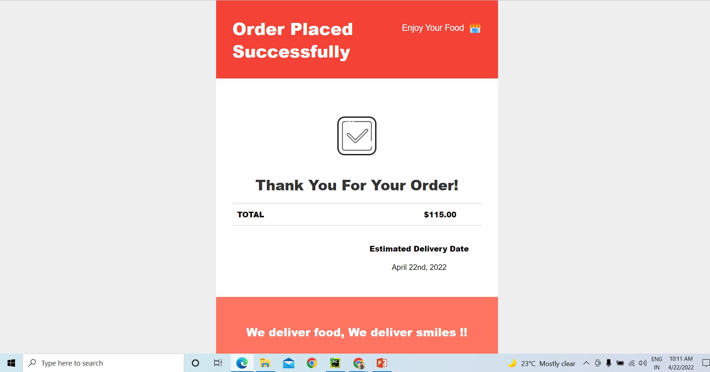
ORDER PLACED

Slide 25
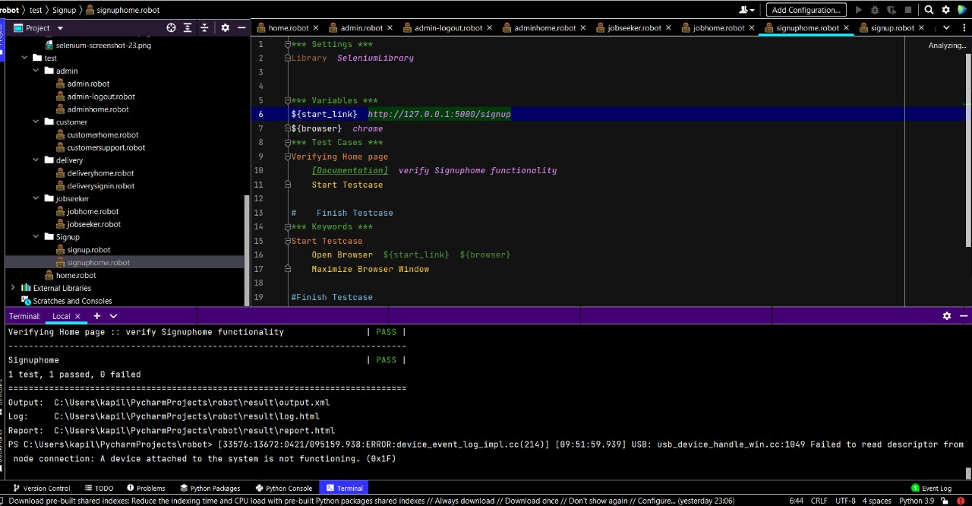
AUTOMATING USER SIGN UP PAGE

Slide 26
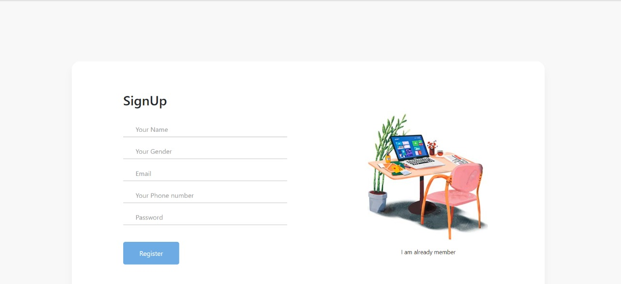

Slide 27
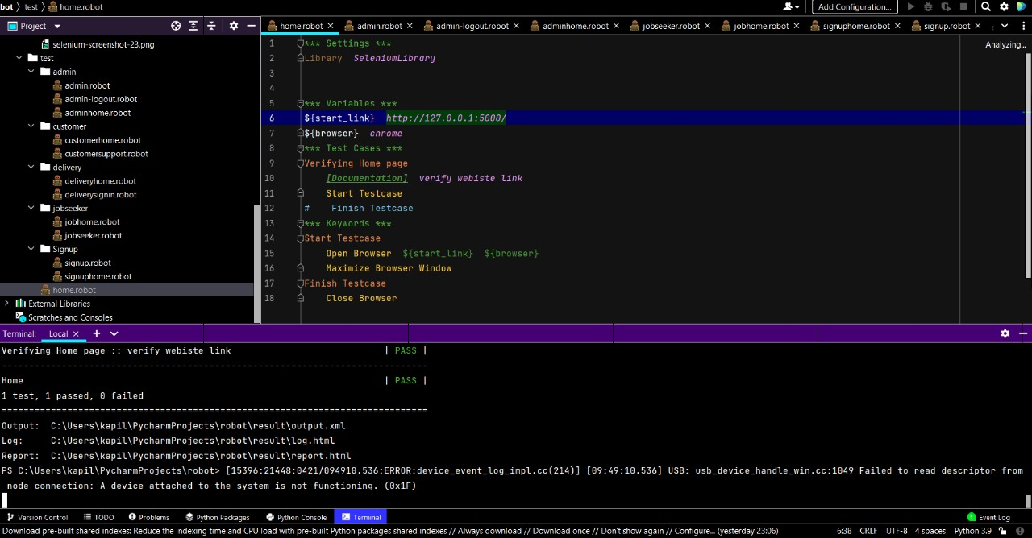
AUTOMATING HOME PAGE

Slide 28
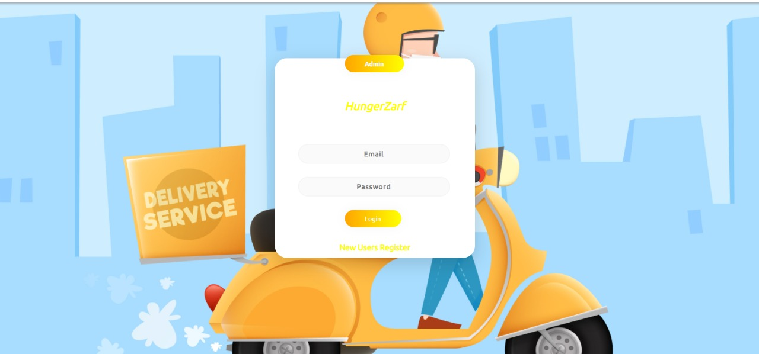

Slide 29
THANK YOU!
PRESENED BY,
NISHANT
VISHAL
NAYANA
KAPIL
UNDER THE GUIDANCE OF,
SARASWATI MAM,
Iprimed

